Slide 1
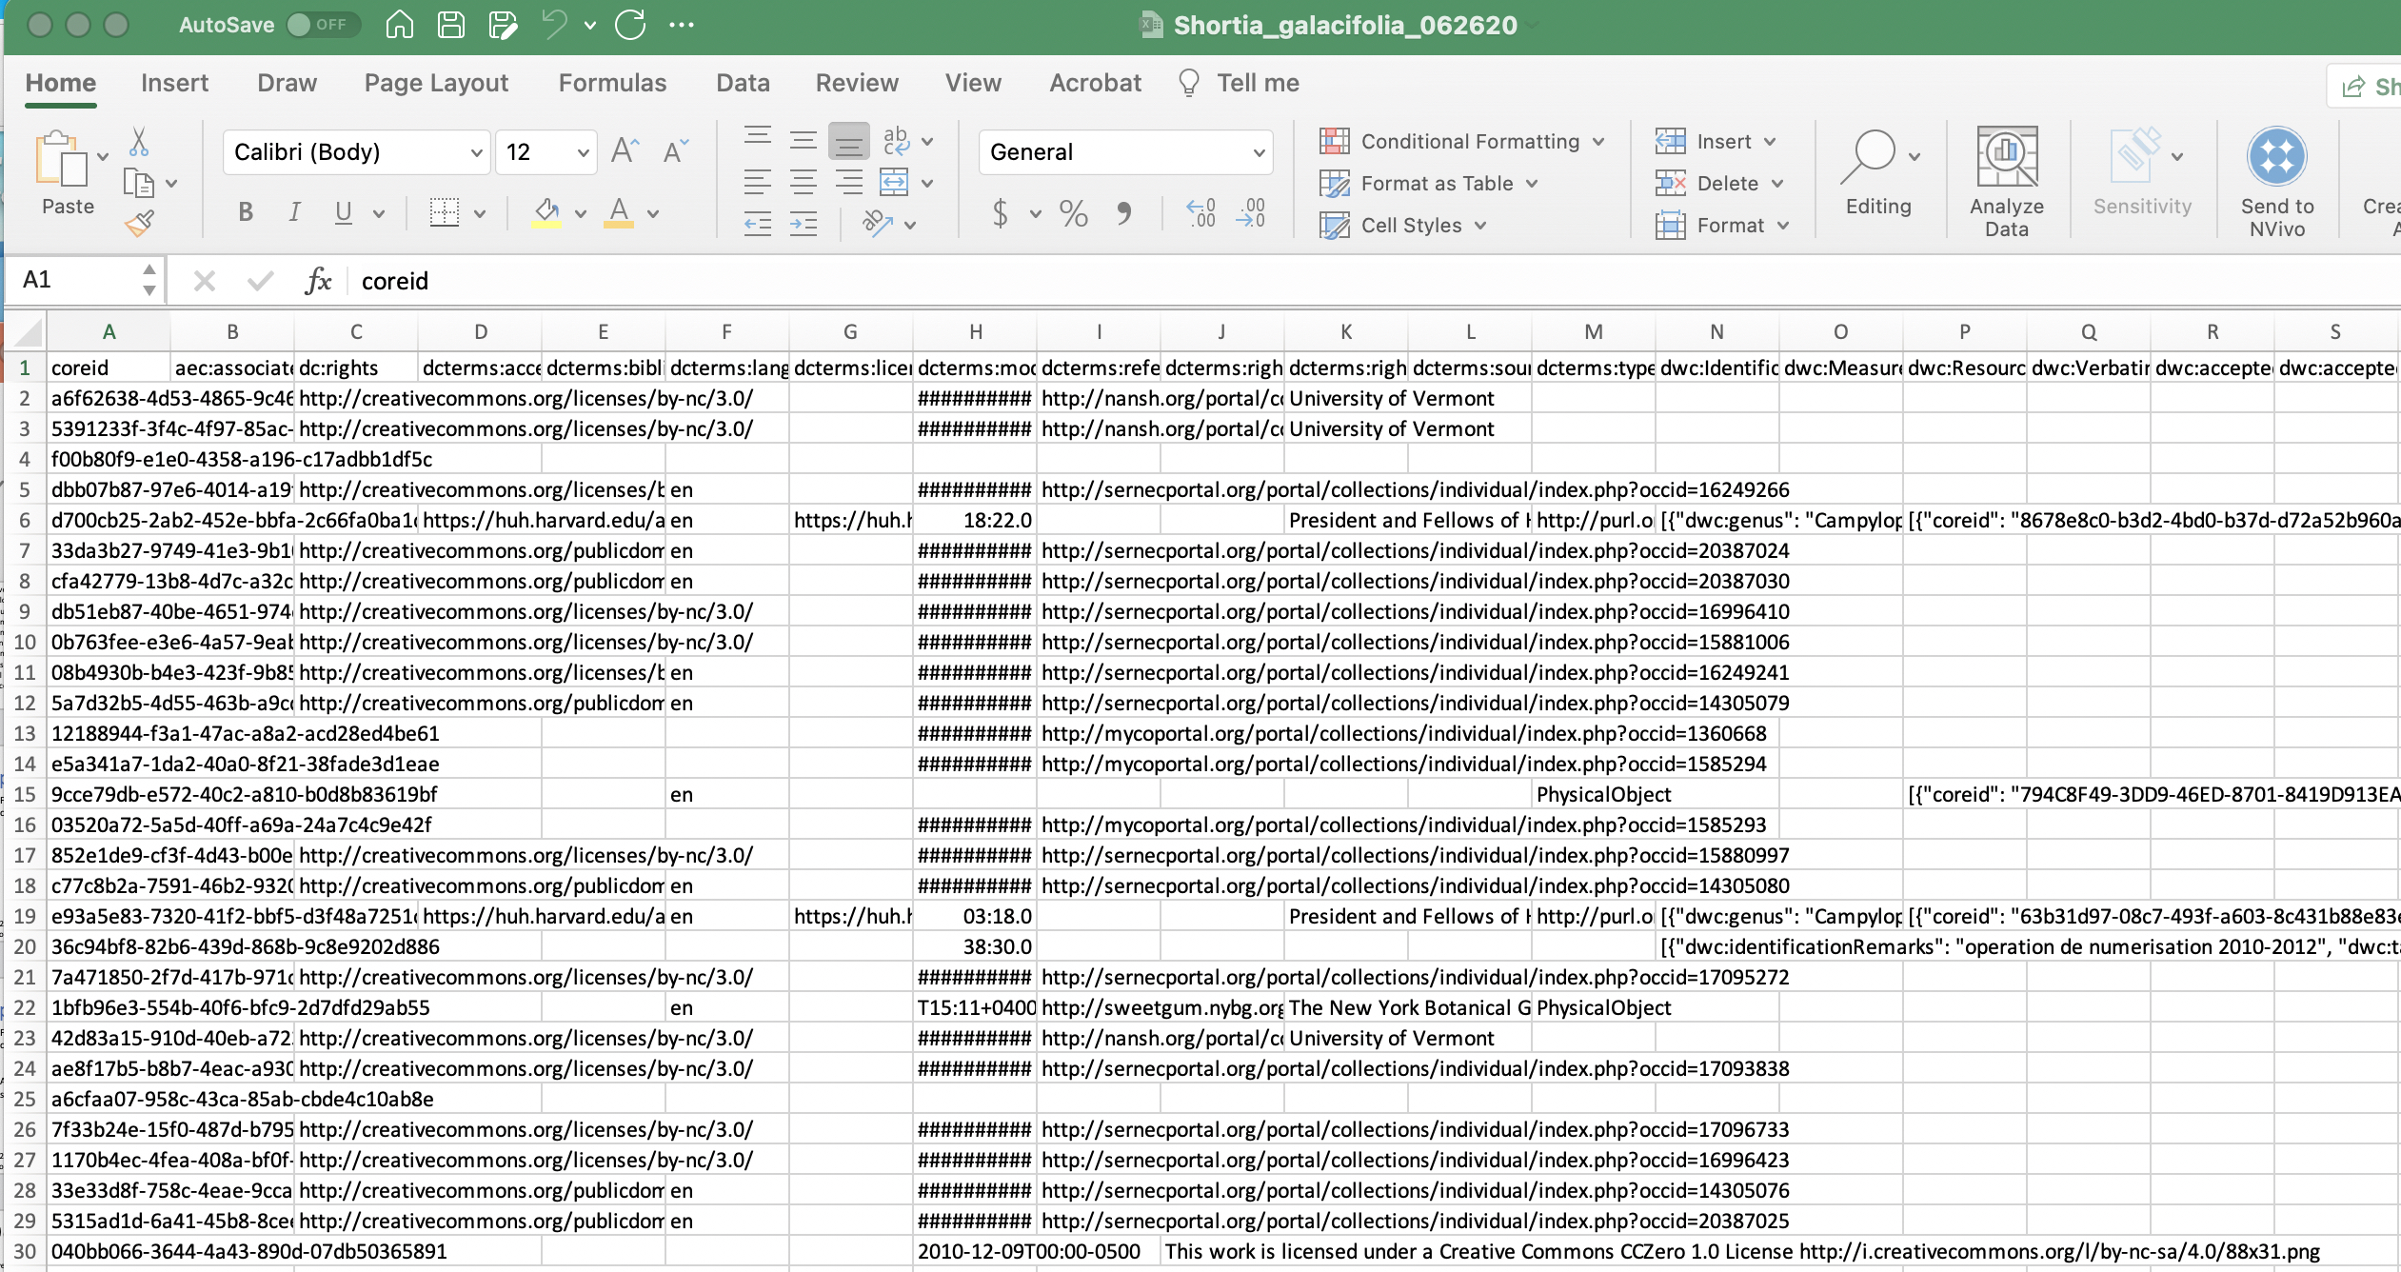
Data Cleaning: Manual
Shortia galacifolia Excel sheet

Slide 2
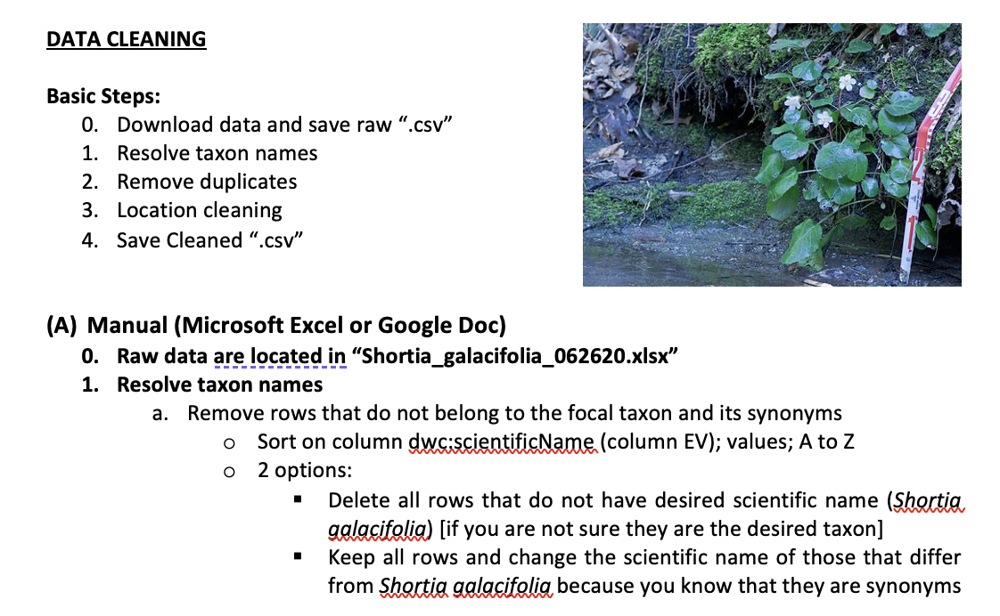
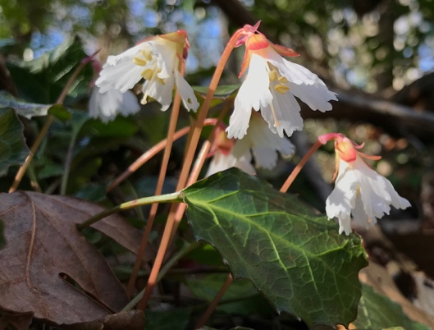
Data Cleaning: Manual
Botany Manual Data Cleaning
document
Shortia galacifolia Excel sheet

Slide 3
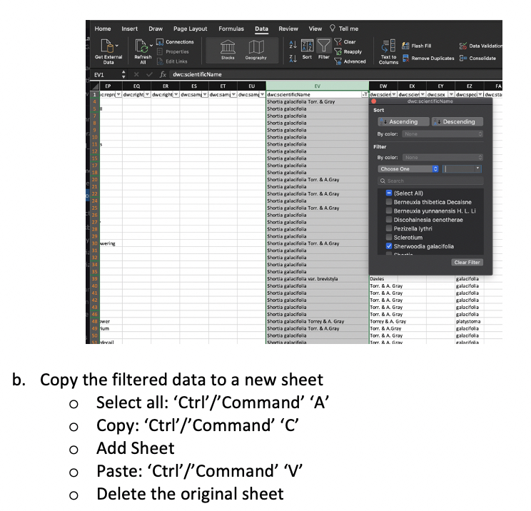
Data Cleaning: Manual

Slide 4
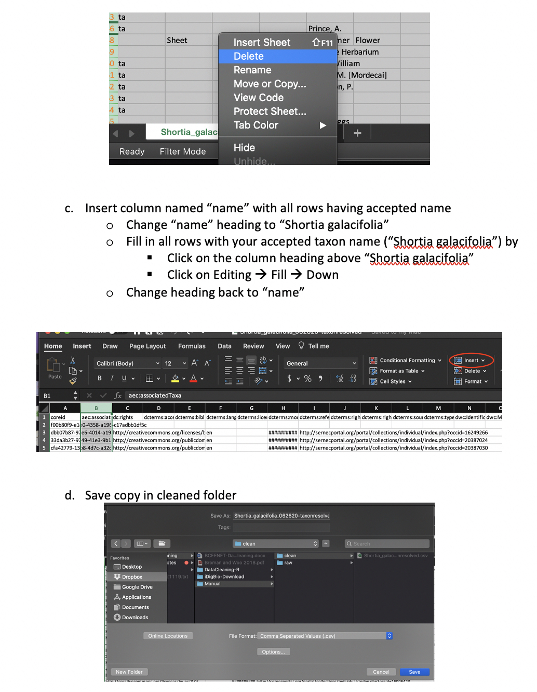
Data Cleaning: Manual

Slide 5
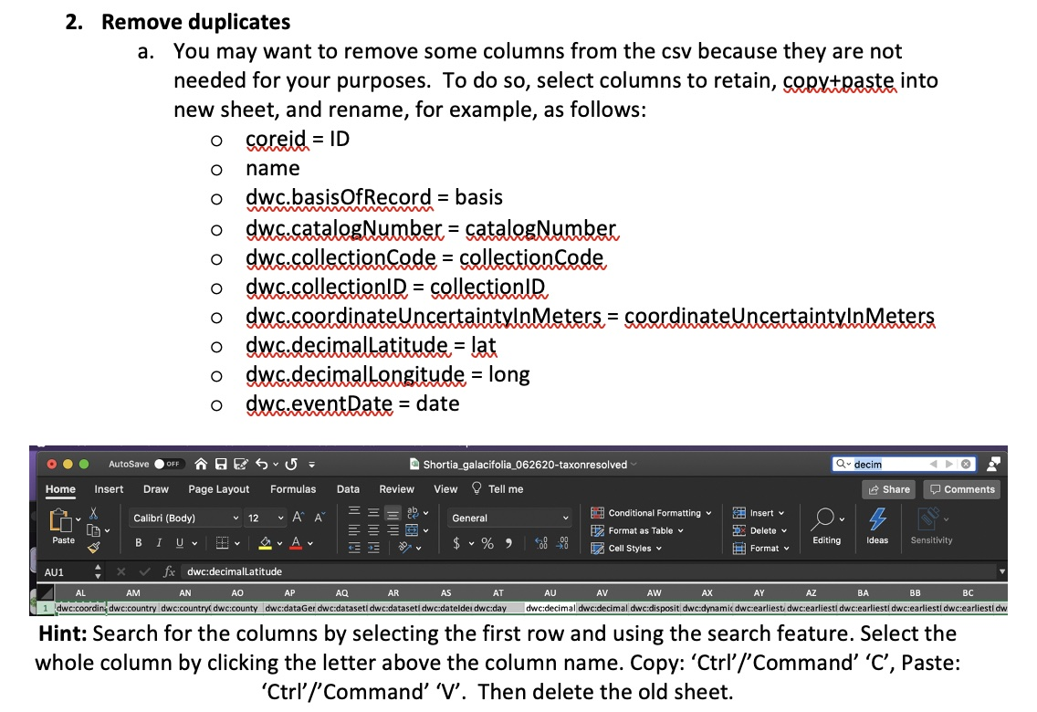
Data Cleaning: Manual

Slide 6
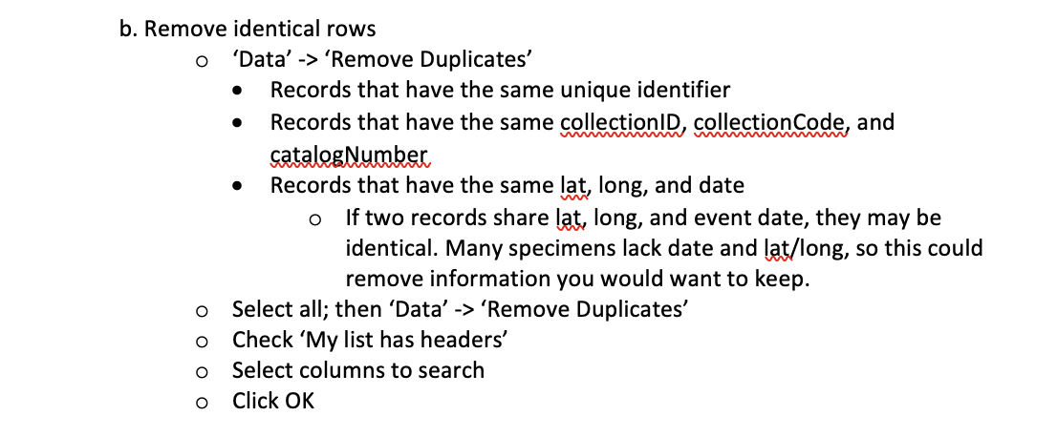
Data Cleaning: Manual

Slide 7
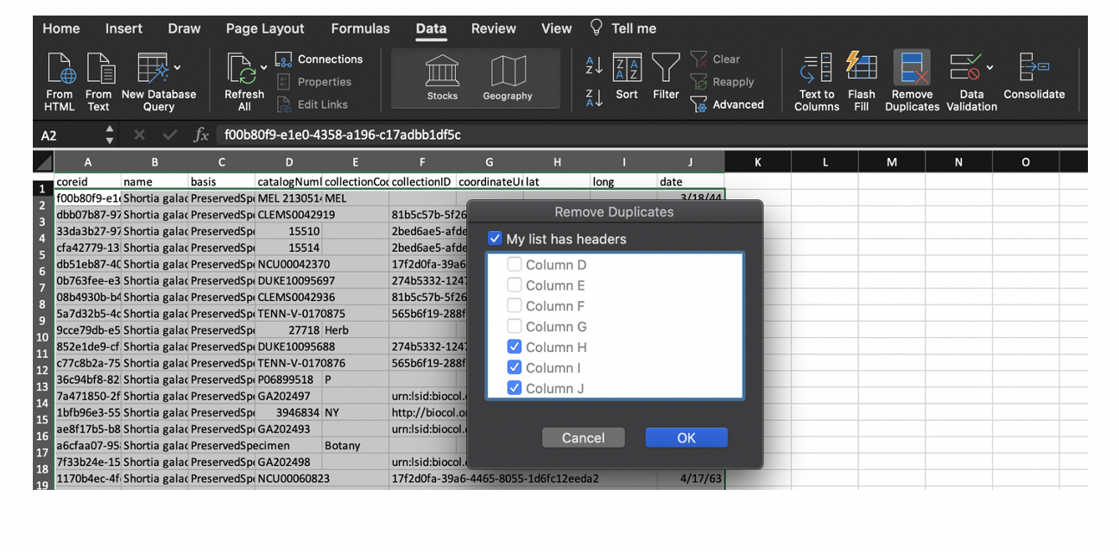
Data Cleaning: Manual

Slide 8
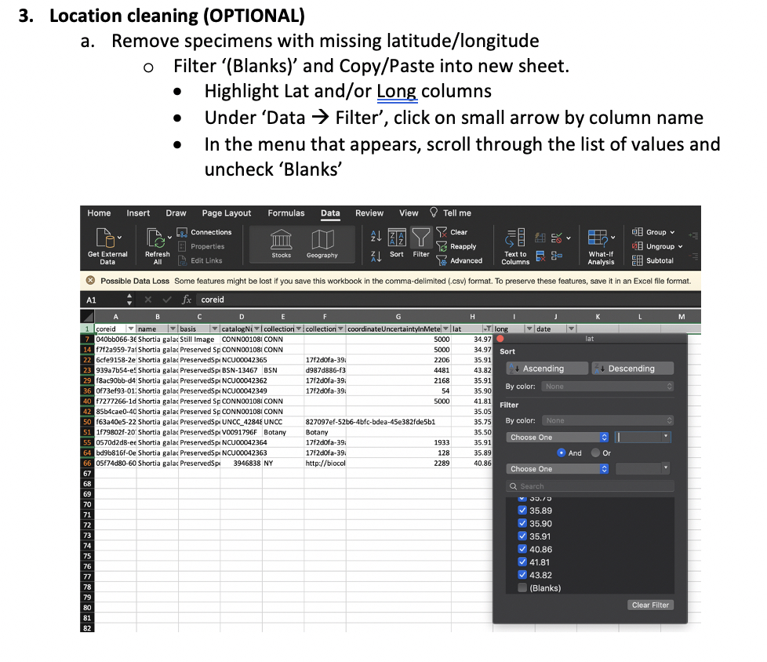
Data Cleaning: Manual

Slide 9
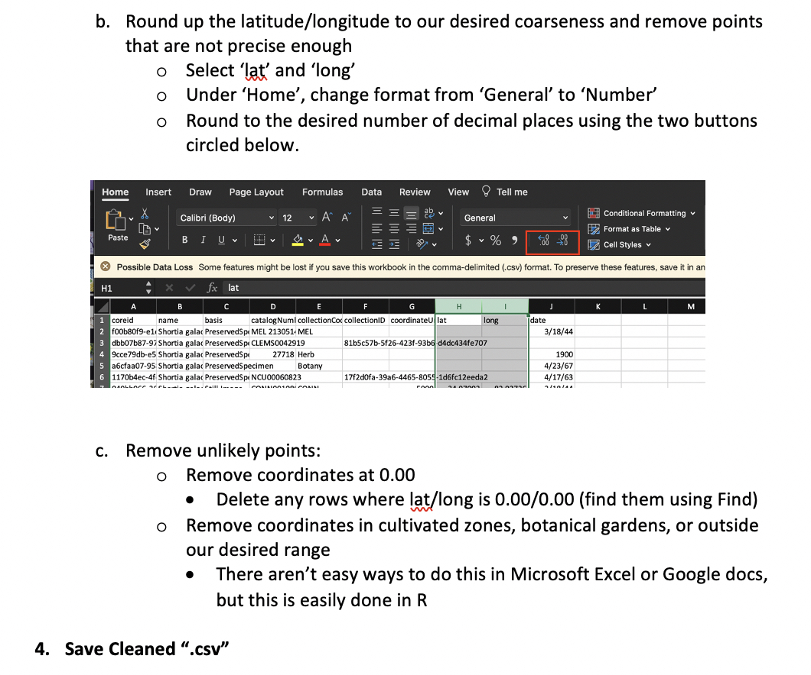
Data Cleaning: Manual

Slide 10

🐊
Geographic And Taxonomic Occurrence R-based Scrubbing
(gatoRs):
An R Package and Reproducible Workflow for Processing Biodiversity Data
Natalie Patten, Shelly Gaynor, Doug Soltis, & Pam Soltis

